Slide 1
Duration: 105 min
Middle School
Grades: 6 - 8
CCSS, NGSS
“My kids just won’t listen.”
“I lose my temper with my children and feel terrible afterwards.”
Raising Well-Behaved Kids:
What Parents Should know
“Spanking stops my kids temporarily, but then they just act up again.”
Adapted From:

Slide 2
Notice the first signs of anger.
It’s important to remain calm when you discipline your children. It’s hard to think carefully about the best course of action to take once you’re mad. When you react out of anger, your response may be more a way of releasing your anger (by hitting and yelling) than an effective way of teaching your child to change a behavior. Common anger signs include:
Clenched Fist or Teeth
Pounding Heart
Breathing Heavily
Hot Face or Ears
Not Thinking Clearly
Wanting to Hit Something
Cracking or Loud Voice
TAKE CHARGE: During the next week, pay attention to the times you are angry and how your body feels when you are angry.
Click on the model to interact
Each person expresses anger differently. Learn the signs that you are getting angry.

Slide 3
Cool down before disciplining your children.
These activities will give you time to calm down so that you can think through a tense situation. You can come up with a parenting strategy that helps your children do what you want them to do without your doing and saying things you may be sorry for later.
Count to 10 and take deep breaths (relaxes the body).
Take a short break and do something relaxing for a few minutes
Exercise, move around, or go for a walk to get rid of some energy.
Imagine yourself in a beautiful, peaceful place like a quiet beach.
Remind yourself that it’s okay to be an imperfect parent.
Remind yourself that this moment will pass.
Remind yourself that your child may not be upsetting you on purpose.
Get another adult involved (either to solve the problem or just to talk with you).
Think of as many reasons as you can for why you’re angry (hint: some reasons might not have anything to do with your child) and write them down so you can put them aside and focus on your child’s behavior.
TAKE CHARGE: During the next week, try one or more of these activities to help calm yourself down
Click on the model to interact

Slide 4
It can be frustrating when you aren’t getting the response you want from your child. Sometimes parents find themselves using the same punishment over and over again for the same misbehavior, even when it doesn’t seem to be effective, because they don’t know what else to do, or because other strategies have also failed.
Here are some ideas that have been shown to work most effectively in changing children’s behavior. For these techniques to work:
It’s important to use them consistently,
Use all the steps suggested, and
Give them a little time.
Be ready for your kids to act out more at first. They may find the change threatening, and it is normal for them to test you to make sure you’re serious about your new approach.
Stick with these approaches, and over time, their behavior should get better.
Learn effective ways to get your children to do what you want.

Slide 5
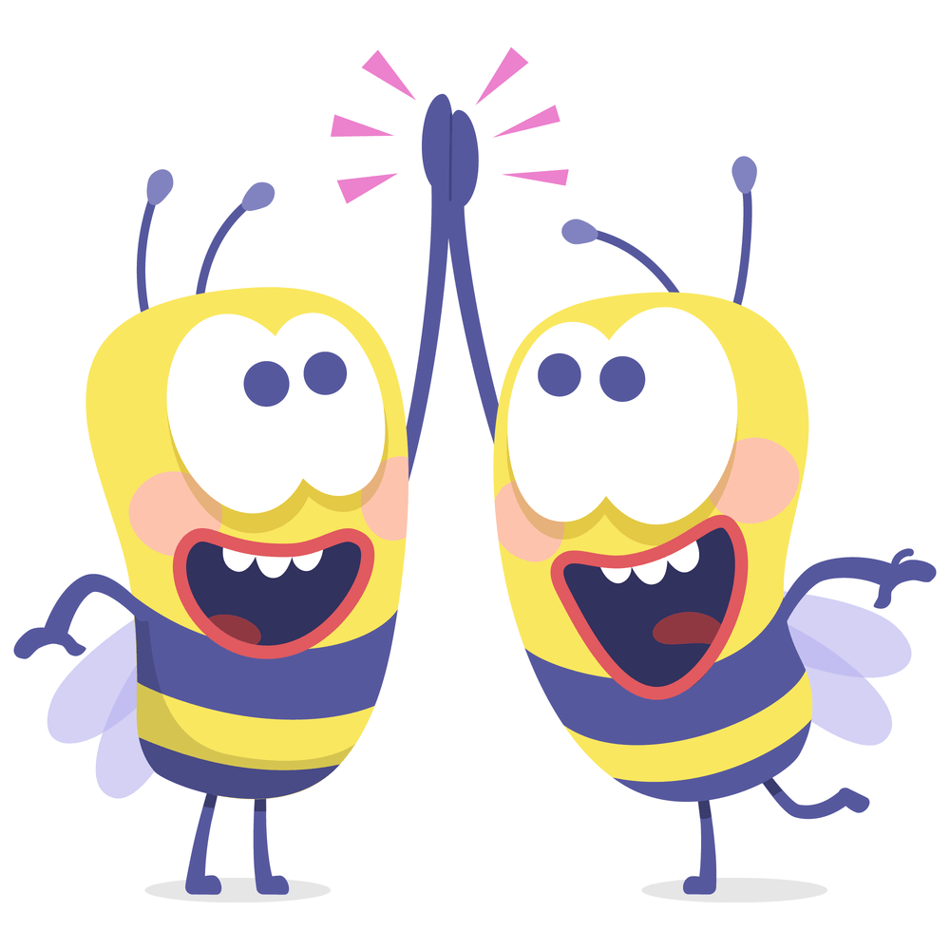
Duration: 105 min
Middle School
Grades: 6 - 8
CCSS, NGSS
Improve Your Relationship:
Laugh at what they think is funny
Play with them
Let them teach you how to do something
Let them take the lead, its how they learn
Show them your love
Children who have a good relationship with their parents may act out from time to time, but ultimately, they want to please their parents and make them proud. Having a good relationship is the best way to get your children to do what you want, and it will bring you closer.
Adapted From:

Slide 6
Try Active Listening
Give your children your full attention
Without judging
Without telling them what to do
Summarize what they are saying
Listen

Slide 7
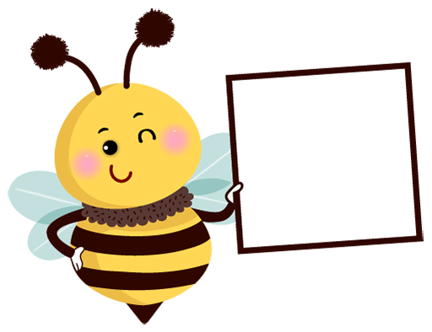
Duration: 105 min
Middle School
Grades: 6 - 8
CCSS, NGSS
State your case in ways that increase cooperation:
Let your children know how they will be rewarded when they do what you want.
Give them choices
Time your requests so that they are at a natural break point in your children’s activity. This decreases resistance, shows them respect, and makes it more likely that they will hear you and cooperate.
Don’t ask a “yes” or “no” question if “no” isn’t an option. For example, don’t say, “Will you get ready for school?” if not getting ready isn’t an option. Say, instead, “Please get ready for school now so we can eat breakfast together and don’t have to rush.
Adapted From:

Slide 8
Duration: 105 min
Middle School
Grades: 6 - 8
CCSS, NGSS
Focus on the Positive:
Children learn best from praise and rewards. They naturally crave praise from the people who take care of them. They will behave the way you want them to if doing so makes them feel good.
Praise and reward behaviors you approve of
Ignore the behaviors that are irritating or annoying.
For example, ignore children when they scream for a toy and praise them when they ask for it nicely. Do not ignore those behaviors that are unsafe.
Adapted From:

Slide 9
Praise
Praise is telling a child that she or he did something well or something you liked.
Be purely positive with your praise and avoid negative talk. For example, when you say, “Thank you for staying quiet while I was on the phone,” a child feels good. If you say, “Thank you for staying quiet while I was on the phone. Why don’t you do that all the time?” a child feels bad. When kids feel good about doing something, they are more likely to do it again.
Be specific. That way, a child knows what to do the next time. For example, say “Christopher, I like how you washed the dishes.” It is more specific and preferable to “Good job, Christopher.”
Provide praise as soon as possible after a child does what you want the child to do.
Be consistent with your praise. The more consistent you are, the more quickly the behavior will change
Click on the model to interact

Slide 10
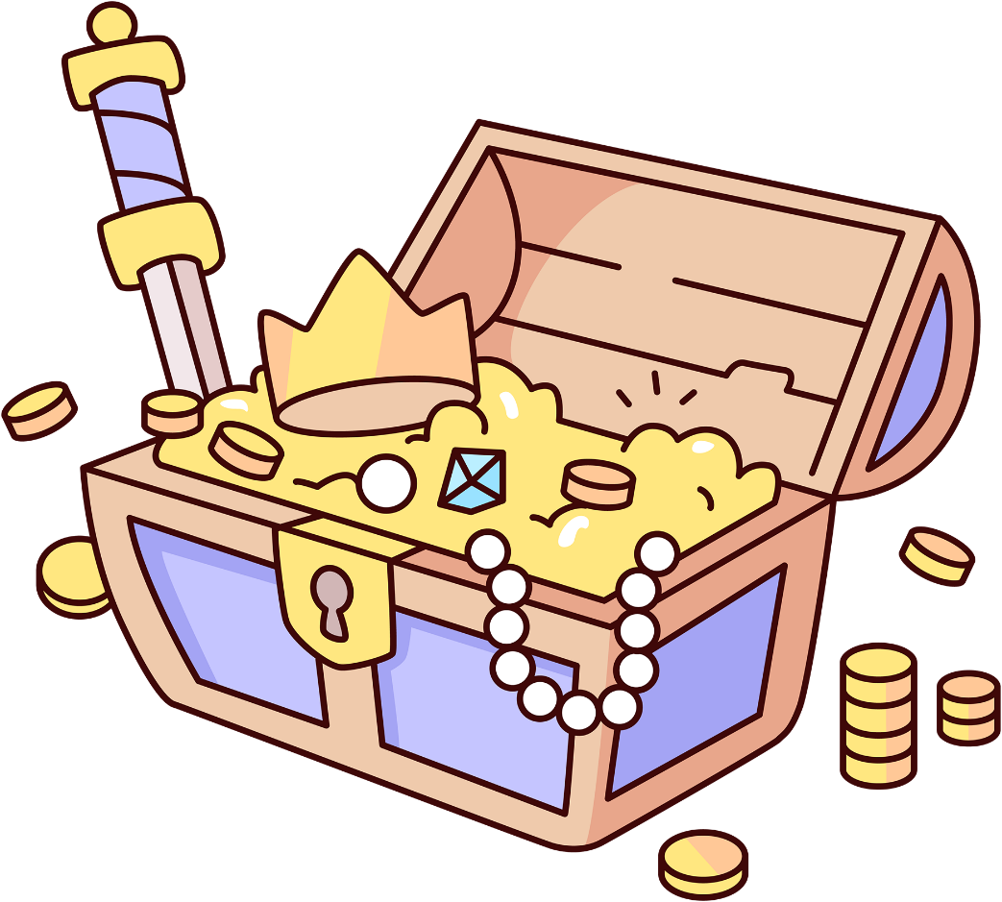
Reward
Reward a child for behaving well. For example, point out when your children are playing quietly together, tell them they have earned a reward and then let them choose.
Let them know what the reward is before you ask them to do something. For example, After you finish cleaning your room, we can play a game.”
Use behavior charts. Set up a plan where your children can earn what they want by doing what you want. It is important to review the behavior chart every day with the child.
TAKE CHARGE: Choose one behavior you want to see more of and praise your child every time he/she does it over the next week
Click on the model to interact

Slide 11
Duration: 105 min
Middle School
Grades: 6 - 8
CCSS, NGSS
Set Clear Consequences:
When trying to stop a problem behavior, it’s helpful to decide on consequences ahead of time and talk to your children about them. That way, you won’t have to think about your options and decide “in the heat of the moment.”
Punishments decided ahead of time are usually more appropriate, less of a knee-jerk reaction, and less of a surprise to your children.
Adapted From:

Slide 12
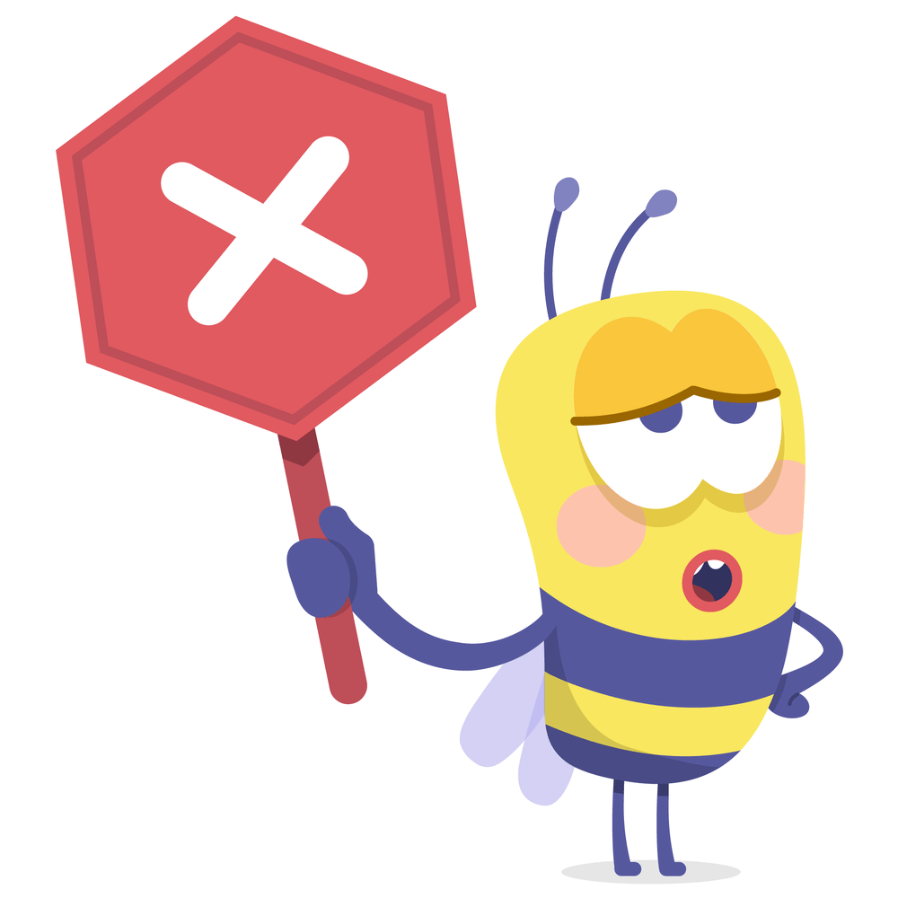
Active Ignoring
Children will do just about anything for attention. Therefore, when you pay attention to behavior even to correct it, the child may do it more.
Active ignoring is purposefully ignoring your child’s minor negative behavior to get her or him to stop.
It is appropriate for minor misbehavior, such as interrupting conversations, and works best when combined with giving the child positive attention and praise for appropriate good behavior.
Click on the model to interact

Slide 13
Time Outs
Time outs are appropriate for children ages 2–10 who refuse to do what they are asked and engage in aggressive or disruptive behavior.
Remove the child from receiving attention and doing fun things for a short time.
Choose a boring place, free of distraction.
Have the child sit on a chair away from the family and TV for one minute for each year of age (five minutes for a five-year-old).
Do not talk to or lecture the child during this time because that is also a form of attention.
If the time out was because the child refused to do something he or she was told, instruct the child to do the task after the time out is completed
Click on the model to interact

Slide 14
Chores
Give the child an age-appropriate chore that the child doesn’t enjoy doing, and that isn’t on his or her chore list. For example, “Because you hit your brother, you have to sweep the floor.”
Click on the model to interact

Slide 15
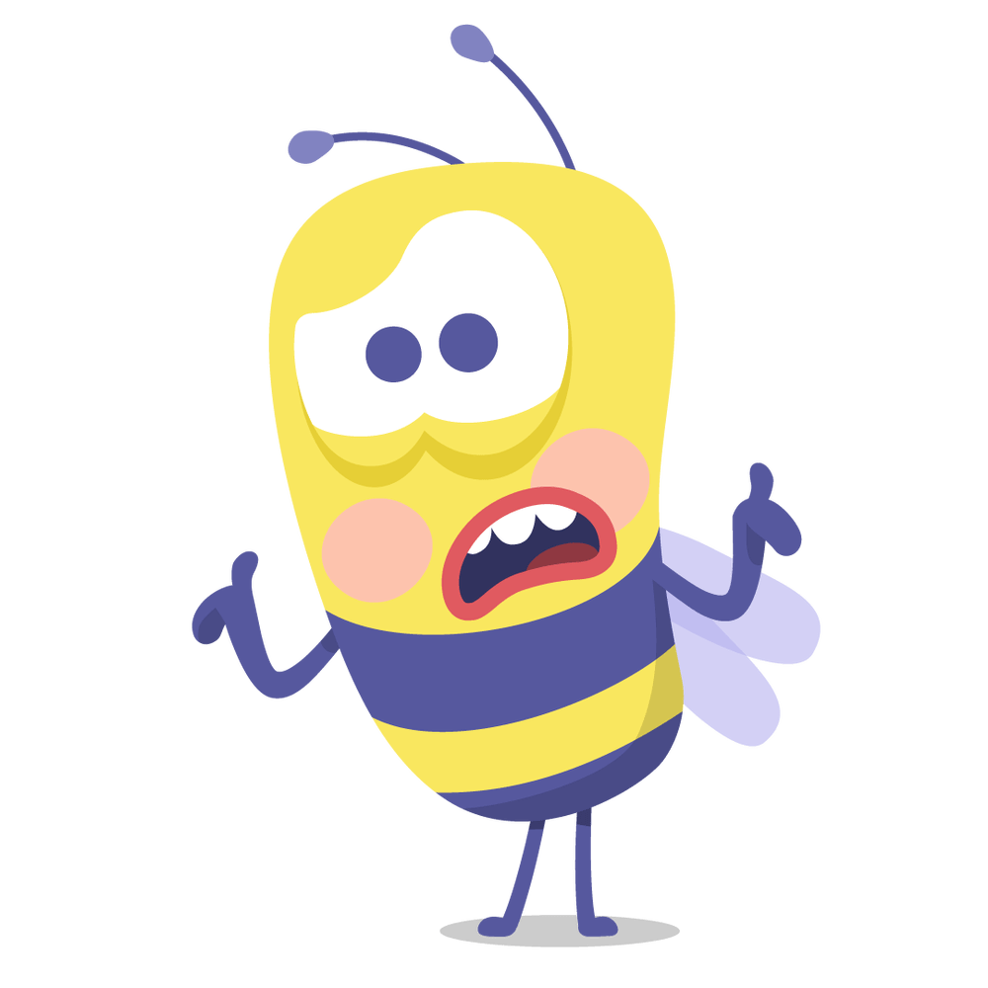
Removal of activity or toy
Remove a toy or an activity that the child likes.
The length of time should be based on the child’s age.
Shorter times are better than longer times. For example, taking a toy away for 15 minutes from a three-year-old who hit her brother with the toy is better than taking it away for a week. With shorter times, your child is more likely to remember why the toy was removed and associate it with the misbehavior. Making the punishment too long (like grounding a child for three months) loses its effectiveness because the child has no incentive to behave. In the child’s mind it comes down to, “Why should I listen? I’m already grounded.”
Removal of an activity or toy can also be used if a child refuses to go to a time out or do a chore.
Click on the model to interact

Slide 16
Consequences
Whatever consequences you choose, be sure to follow through with them.
Avoid making empty threats; they teach children that you don’t always mean what you say.
And remember, consequences work best when used in combination with the positive approaches listed above
TAKE CHARGE: Try one or two of these consequences for at least one month and track how often your child does the behavior you don’t like
Consistency is the hardest part of parenting. Whether we are talking about discipline, or maintaining routines, such as those around bedtimes, lots of studies tell us that consistency is the healthiest approach for children
Click on the model to interact

