Slide 1

MY THERAPY BOOK

Slide 2
Welcome to therapy!
Therapy is a safe place to help you feel better about upsetting or confusing events that you have experienced. You will get to draw, write, and talk in therapy. You will learn many important things about:
Upsetting/confusing events
Feelings
Relaxation
How to stay safe.
Your thoughts, feelings, behaviors, and strengths.

Slide 3

Write or draw how you feel about being here today:

Slide 4

Do you have any questions about therapy?

Slide 5

About You
You are a very special and unique person. There are many special things about you and a lot of things you are good at.
What are some things you like to do for fun?

Slide 6

Who do you live with?
Who is in your family?
What are some things you like about your family?
What do you and your family like to do together?

Slide 7
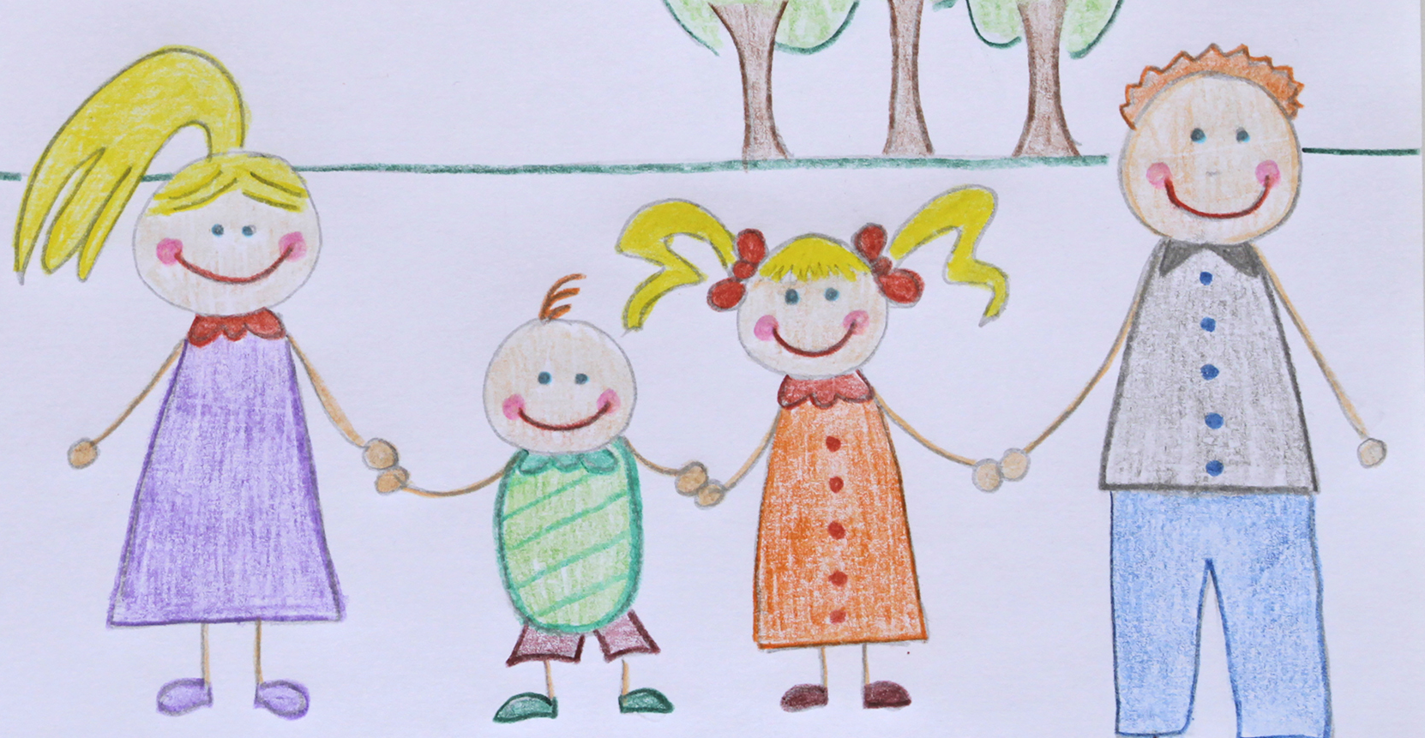
Draw or write some of these things:

Slide 8
Learning About Upsetting Events
Upsetting/confusing events are also called traumas. Traumatic events can cause people to feel very afraid, upset, confused, helpless, angry, empty or numb. There are different kinds of traumas. Let’s learn about the traumatic event(s) that you experienced. Your therapist will help you answer some common questions teens have about traumatic experiences. If you have experienced more than one type of trauma, your therapist will talk to you about how to understand these experiences.
What is it called?
What does that mean?
Who does this happen to?
Do a lot of teens experience this?
Why does this happen?
What can teens do if this happens to them?

Slide 9
Your trauma
What is it called?
What does that mean?
Who does this happen to?
Do a lot of teens experience this?
Why does this happen?
What can teens do if this happens to them?

Slide 10
How Do Teens Feel After Trauma?
Many teens have scary memories or dreams about trauma. Some teens also feel jumpy or nervous or angry. After trauma, a lot of teens watch out for danger and worry about bad things happening. Some teens also have trouble sleeping and paying attention in school. A lot of teens feel like they DON’T want to talk about or think about the trauma(s), but trauma memories pop into their minds anyway. When something reminds them of the trauma(s), teens may feel upset and may have strong reactions in their bodies (heart beating fast, stomach ache). Other teens may feel empty and numb, like they can’t feel anything at all. They may use drugs or alcohol to try to deal with upsetting feelings.
Which things have you experienced since the traumatic event?
Jumpy
Angry
Watch out for danger
Worry about bad things
Don’t want to talk about it
Don’t want to think about it
Memories pop into my mind
Stomach aches

Slide 11
What is Relaxation?
Relaxation is about feeling calm and peaceful. After traumas happen, we often feel tense, jumpy, and worried. We feel better when we learn to relax our bodies and minds! This exercise teaches us how to relax using our muscles:
Sit comfortably in your chair with your arms at your sides and your feet planted on the floor. Close your eyes or look down at the ground while you do this exercise. Imagine that you have a ball of clay in your right hand. Squeeze that ball of clay as hard as you can! While you are squeezing, feel how tight the muscles of your hand and arm are. Count to five as you squeeze, then drop the ball of clay and let your hand hang loose. Feel the difference in the muscles of your hand and arm when they are relaxed. Repeat to yourself, “My hand is relaxed.” Now do the same thing with your left hand. You can do this with all the parts of your body one at a time or all at the same time (your therapist will help you)! Which way would you like to do it? Don’t forget to include all your muscle groups (arms, feet, legs, stomach, back, chest, shoulders, face).
What are some things you do that help you feel relaxed?

Slide 12
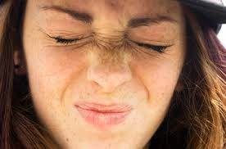
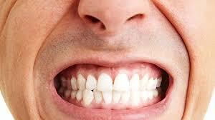
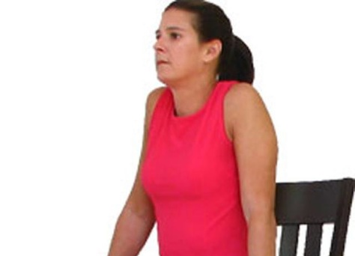
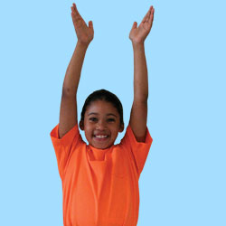


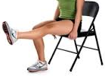
Muscle relaxation
Face
Mouth
Shoulders
Arms
Hands
Stomach
Legs

Slide 13

Let’s Relax! The Cloud
Many teens have trouble calming down or falling asleep at night. If this ever happens to you, practice this activity at home. A family member or friend can read it to you before bedtime or any other time when you want to relax.
Lie down or sit comfortably somewhere quiet and cozy (your bed, a couch). Breathe in slowly and out even more slowly. Close your eyes and imagine you are floating on a soft, fluffy cloud. You feel very safe on your cloud as it cradles your body like a hammock. Your whole body feels very relaxed and heavy. Notice your feet. Your feet feel very relaxed. Your feet feel so heavy that it would be hard to lift them if you tried. Now notice your legs. Your legs feel very relaxed. Your legs feel so comfortable all nestled into your cloud. That nice, warm, relaxed feeling is slowly traveling up your body, filling it with peace. Notice your stomach. It feels very calm and filled with a pleasant warmth. Now be aware of your chest. Your chest feels relaxed as it moves up and down slowly with each breath. Notice your neck and shoulders. They feel so tranquil and heavy. Feel the backs of your shoulders touching the cloud below you, sinking in gently. Feel how relaxed your head is right now. It feels very warm, pleasant, and heavy. Your head and face are very relaxed. Your mouth and eyes are free of stress. Allow your thoughts to come and go without worrying about anything. Everything is okay, and you are feeling very calm and good. Enjoy the warm, calming sensation as it travels all around your body, filling you with peace and relaxation.

Slide 14
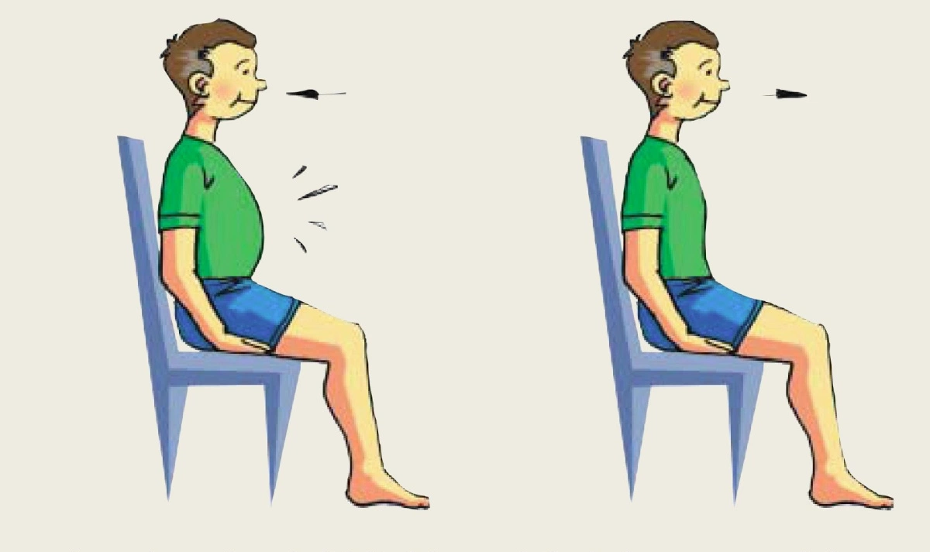
Deep breathing

Slide 15

Deep Breathing
Sometimes when we are upset, we forget to breathe. Or we take short, shallow breaths (like a puppy dog panting) that don’t give our bodies the oxygen we need. To help ourselves feel relaxed and calm, we can practice deep breathing.
Deep breathing is when you breathe in slowly and deeply (counting to 5 in your head) as your lungs fill up with air (you can watch your belly stick out as you breathe in). Then you let the air out, EVEN SLOWER (count to 6) and watch your belly go back in as the air is slowly pushed out. Pay attention to the air as it moves in and out of your body as you count.
Fun games with deep breathing:
1. Breathe out to empty the air out of your lungs. Breathe in deeply and evenly through both nostrils. Hold your breath for a count of five. Use your left thumb to block off your left nostril and breathe out slowly through your right nostril. Breathe in deeply through your right nostril and hold your breath for five counts. Now block your right nostril with your right thumb and breathe out slowly through your left nostril. Repeat several times.
2. Put on some slow, relaxing music. Close your eyes and listen to the beat. Take a deep breath in for 3-5 beats of the music, hold your breath for 3-5 beats, and then breathe out slowly for 3-5 beats. Repeat, pairing your breathing with the music.

Slide 16
Feelings
Feelings are what we feel in our bodies and hearts. There are many different feelings that we have, and our feelings may change from moment to moment. Sometimes we even feel two or more feelings at the same time!
Please write down as many feelings as you can think:

Slide 17
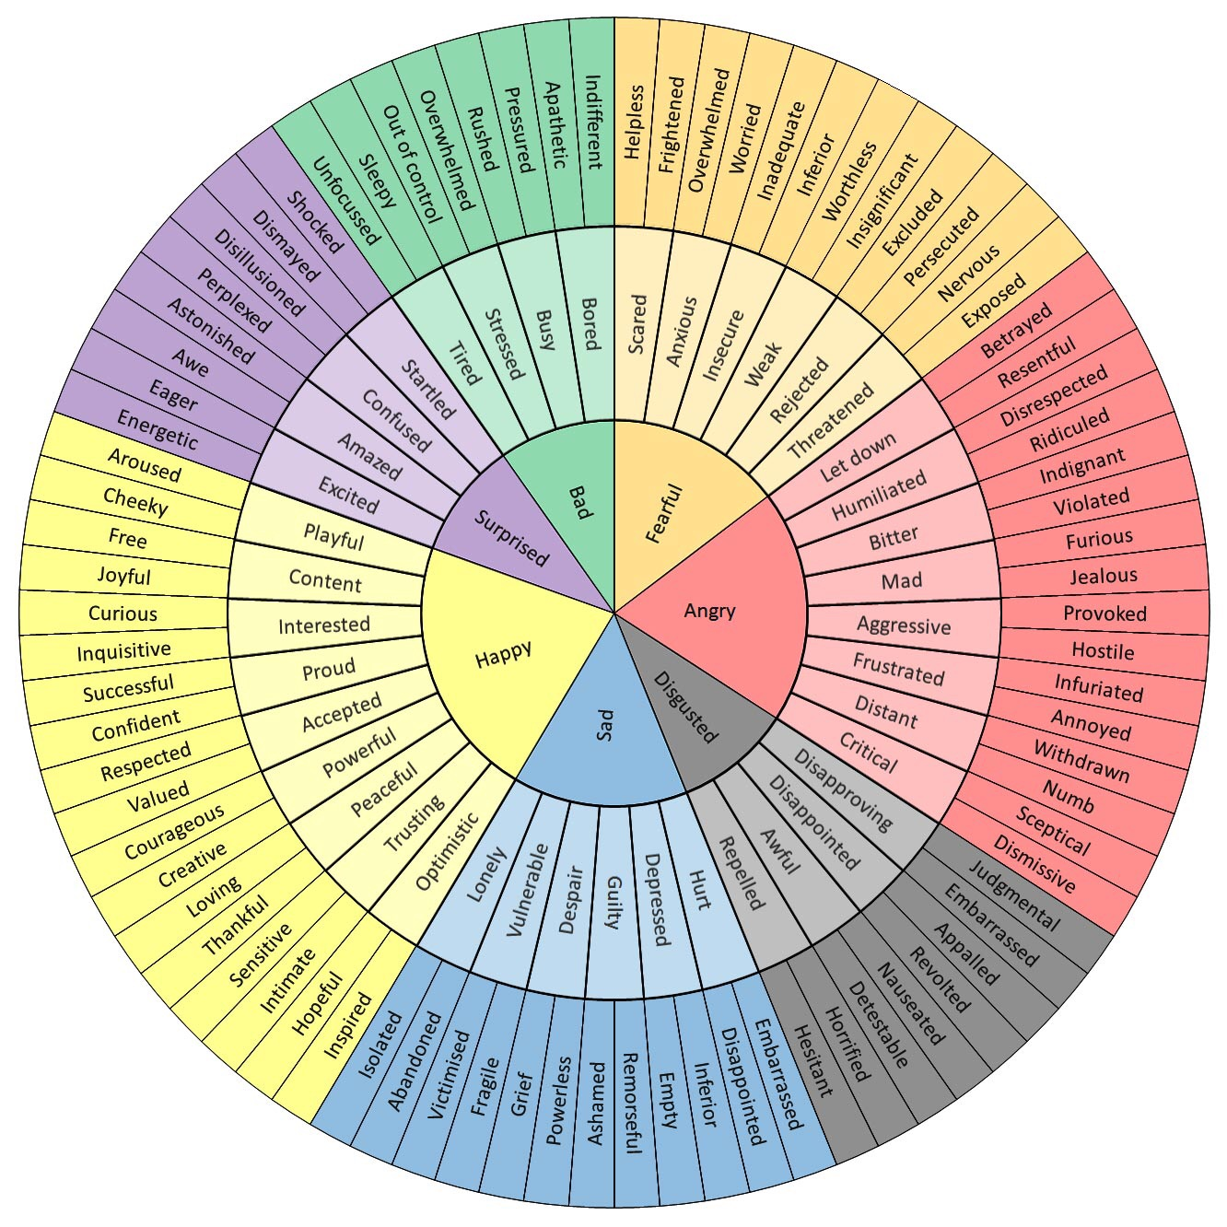

Slide 18
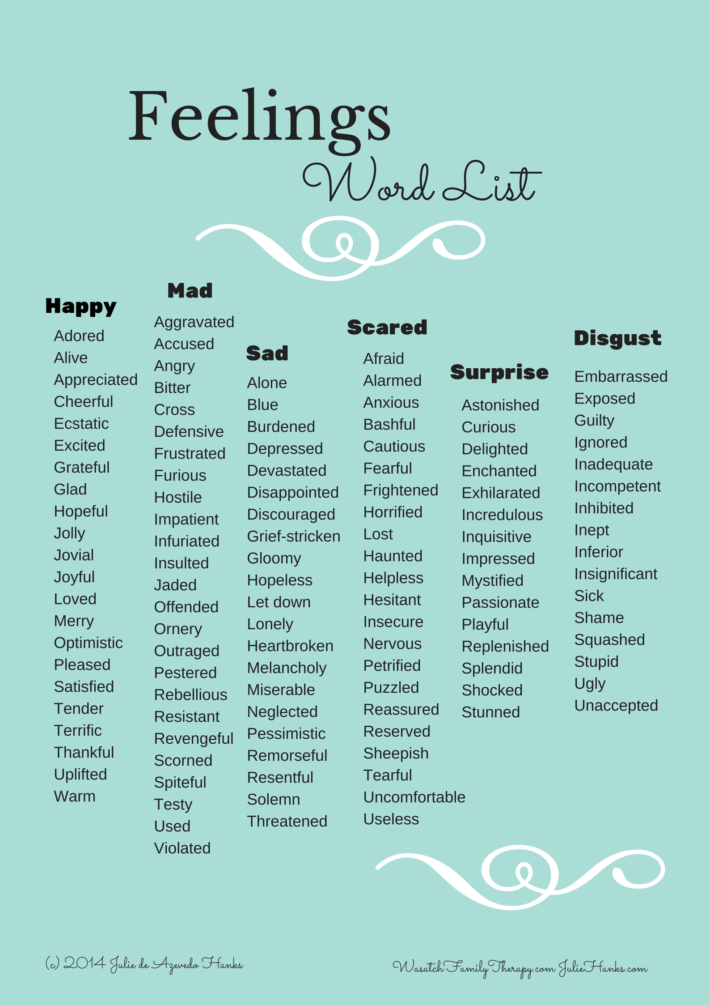

Slide 19
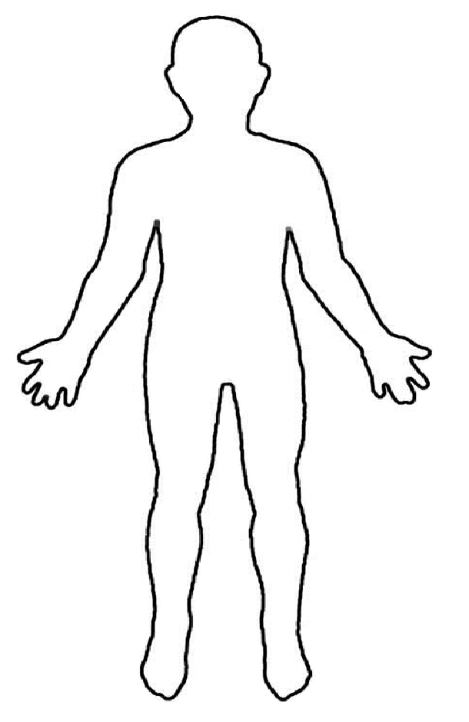
Feelings in my body
Happy
Sad
Angry
Scared

Slide 20




How Do You Know When You Feel…
Happy
Sad
Scared
Mad

Slide 21
Feelings Charades!
A good way to tell how we feel and how others feel is by noticing facial expressions. Take turns acting out the above feelings; the other person tries to guess which feeling you are acting out! Then you get to tell what makes you feel that way. You can also play this game at home.
Happy
Sad
Mad
Scared
Nervous
Excited
Confused
Shocked
Proud

Slide 22



10
9
8
7
6
5
4
3
2
1
0
“Angry” Scale

Slide 23



10
9
8
7
6
5
4
3
2
1
0
“Sad” Scale

Slide 24



10
9
8
7
6
5
4
3
2
1
0
“Happy” Scale

Slide 25



10
9
8
7
6
5
4
3
2
1
0
“Scared” Scale

Slide 26
Ways to Feel Better:
Stop whatever you are doing, close your eyes, and take 10 slow, deep breaths. Visualize your “safe place.”
Listen to your favorite music. Pray, meditate, or focus on your special relaxation phrase.
Go outside and take a walk in a safe area.
Call a friend.
Talk to a parent or other adult who understands and listens. I can talk to my Grammy.
Tell yourself that things will get better.
Take a warm bath.
Use the stress ball.
Tell yourself 5 good things about yourself: I am a helpful person. I have lots of friends that care. I’m good at basketball. I am cool. I am smart.
Talk about your feelings.
Tell someone you love him/her.
Do something to help someone else.
Drawing.

Slide 27
Thoughts, Feelings, and Behaviors
Happy
Running
I’m smart!
Hitting
They don’t like me.
Sad
Playing
Mad
I can do it!
It’s my fault.
Worried
Hiding
Crying
Singing
Lonely
She’s mad at me.
Eating ice cream
Taking a walk
Excited
I’ll be OK
Scared
Taking a deep breath
Hopping on one foot
Brave
Talking to a friend
Safe

Slide 28

What is he thinking?

Slide 29
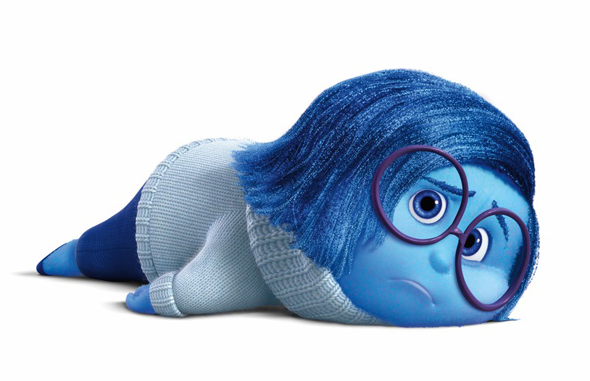
What is she thinking?

Slide 30
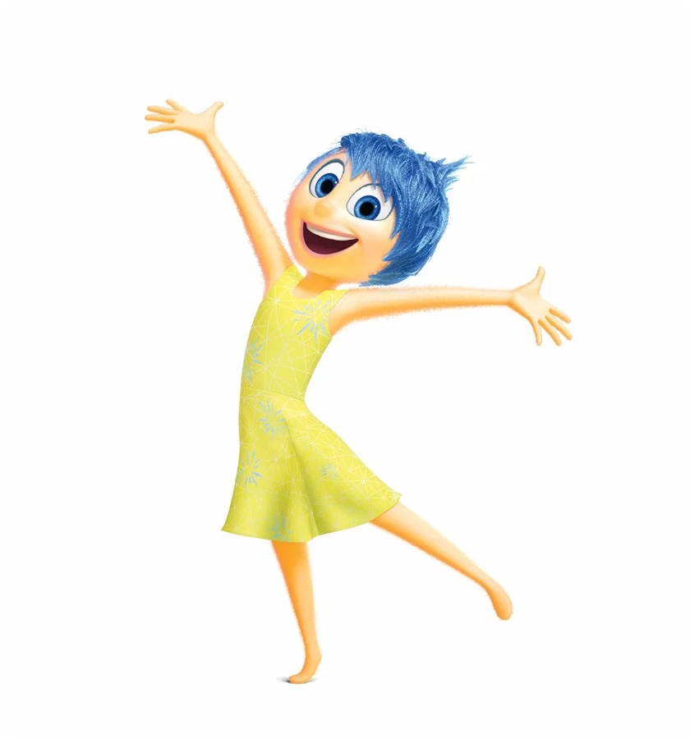
What is she thinking?

Slide 31
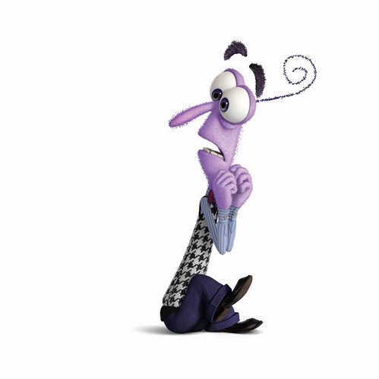
What is he thinking?

Slide 32

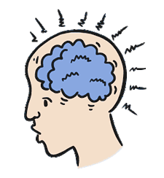

Thoughts are connected to our feelings, feelings are connected to what we do!

Slide 33
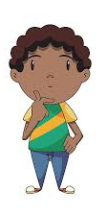
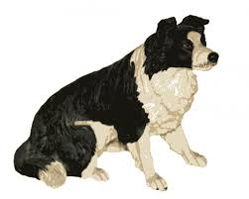
Thoughts Feelings!
What feelings would follow this thought?
That dog is staring at me. He looks mean. I bet he wants to jump on me or bite me!
FEELING =

Slide 34
Thoughts Feelings!
What feelings would follow this thought?
That dog is looking at me. He seems interested and friendly. I bet he wants to play!
FEELING =

Slide 35
Ask yourself:
Is this thought helpful?
Yes = Great! Keep doing what you’re doing!
No = Let’s think of a more helpful thought.
Feeling:
Situation:
Thinking:
Doing:

Slide 36
Ask yourself:
Is this thought helpful?
Yes = Great! Keep doing what you’re doing!
No = Let’s think of a more helpful thought.
Feeling:
Situation:
Thinking:
Doing:

Slide 37
TITLE
Chapter 1: About Me
Chapter 2:
Chapter 3:
Chapter 4:
Chapter 5: The Future

Slide 38
My Circles of Support

